Slide 1
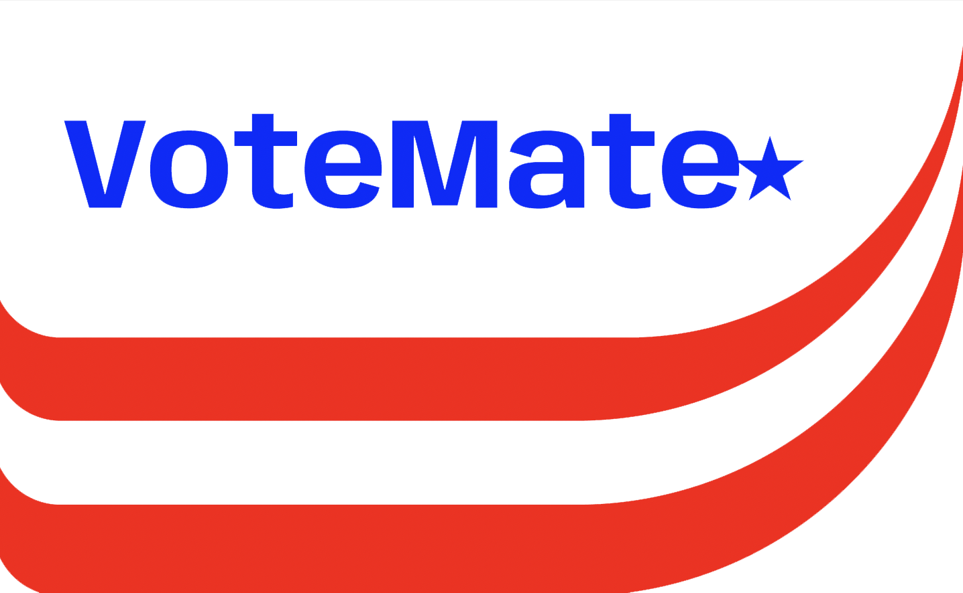
Byte Bandits
Voter Tracking and Election Monitoring Analytics Tool
Emily Brink
Nicklas DiPietro
Robel Hailu
Gary Larson

Slide 2
Summary
Votemate Demo
Database Design
  Vote Profiles & Registration
  Ballots
  Web Media & Click streams
Data Analytics
  Extent of Media Influence
  Reports for private and public consumption

Slide 3
Notes:
Demo time! https://www.figma.com/proto/jle7fhgiDeo7ChvSq1sSKJ/VoteMate?node-id=1-4&scaling=scale-down&page-id=0%3A1&starting-point-node-id=1%3A4

Slide 4
Database Design
Notes:
Under the hood of VoteMate…

Slide 5
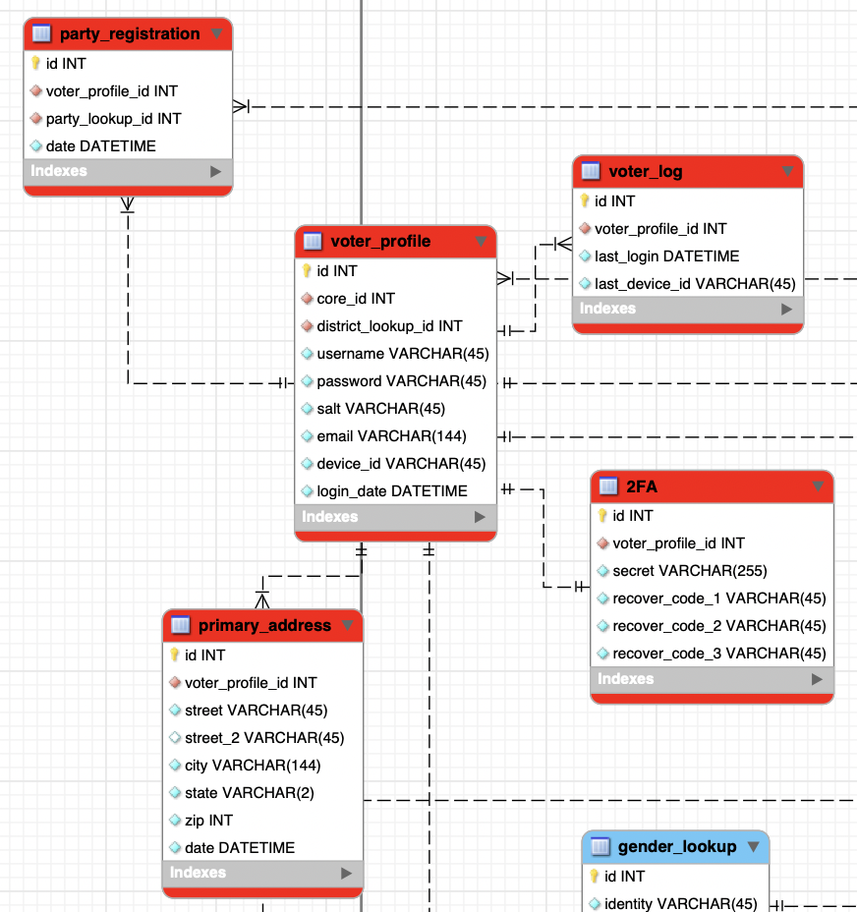
Voter Profile
Unique profile for each voter
Authenticate voter
Detect external influences
Notes:
We will discuss swaying in data analytics section, authentication in the next slide with sample queries

Slide 6
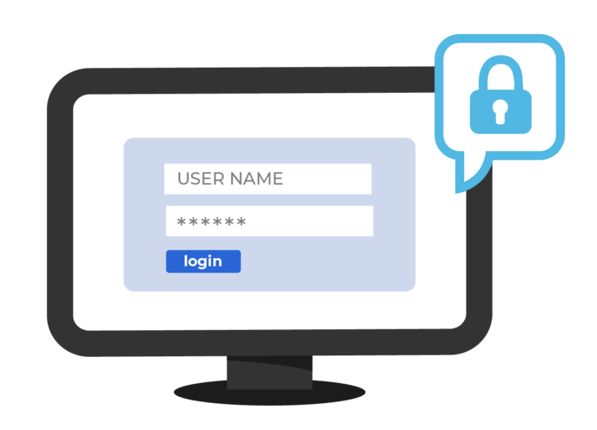
Sample Query for Voter Authentication:
Result of Query:
SELECT vp.id, vp.username, vp.password, vp.salt, t.secret
FROM voter_profile vp
JOIN 2fa t ON vp.id = t.voter_profile_id
WHERE vp.username = 'jane_doe'
Notes:
At a high level, this query result helps visualize how this data will be encrypted and hashed to create the password for voter authentication

Slide 7


Election Votes
Upon authentication, user can vote
Focus is on general elections
Casting of votes done through phones
Notes:
Upon user being authenticated through login process, user can now continue to the voting process where they can vote on a given ballot

Slide 8
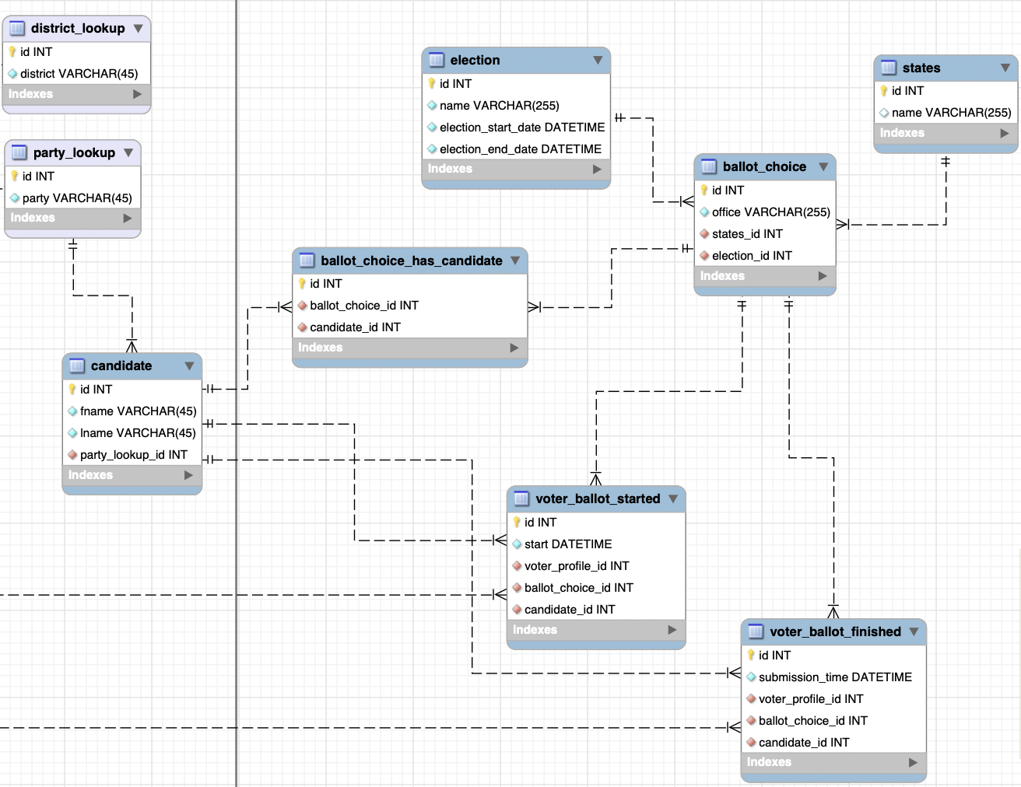
Voting Process
Process starts once user has logged in
Tracking start and finish date/time of voters voting process
Users vote stored after submission

Slide 9
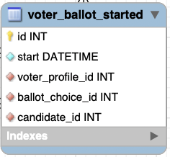
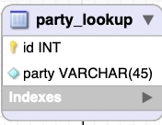
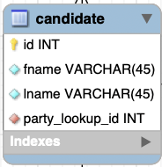
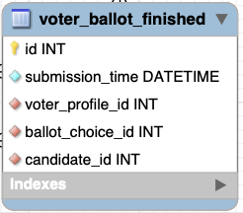
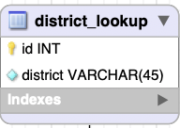
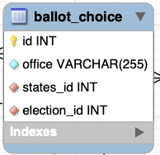
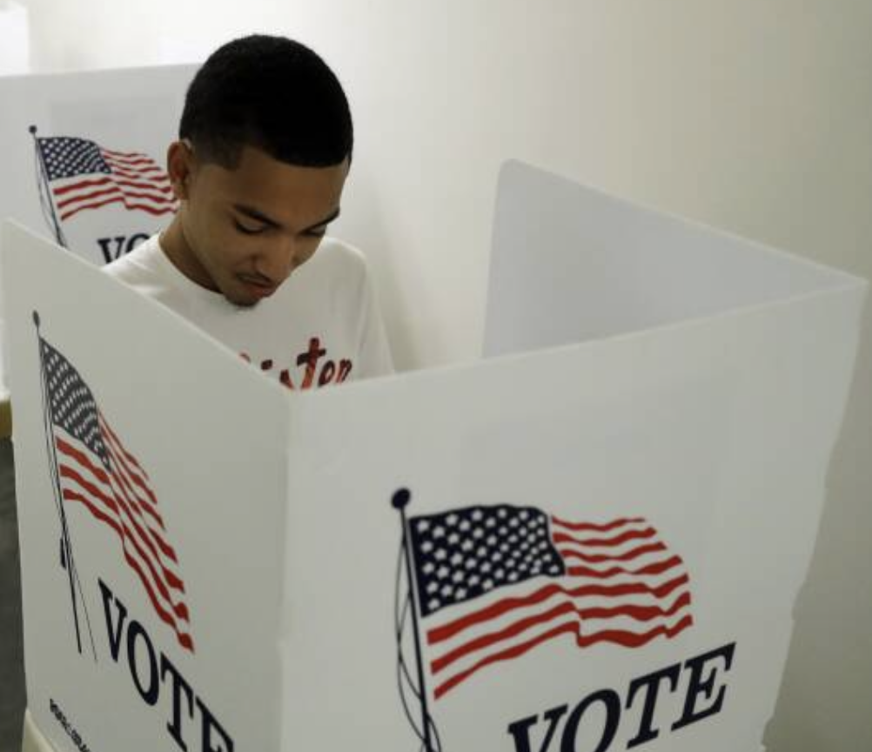
Ballot Gathering & Storage

Slide 10
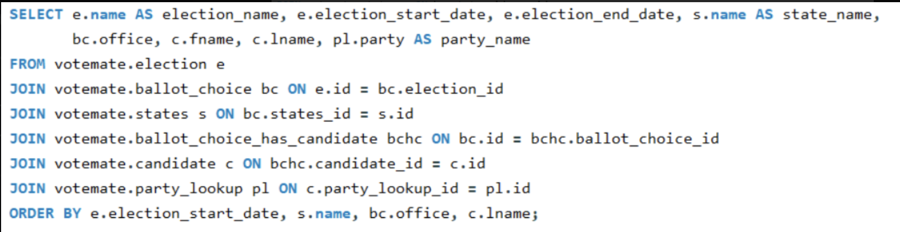
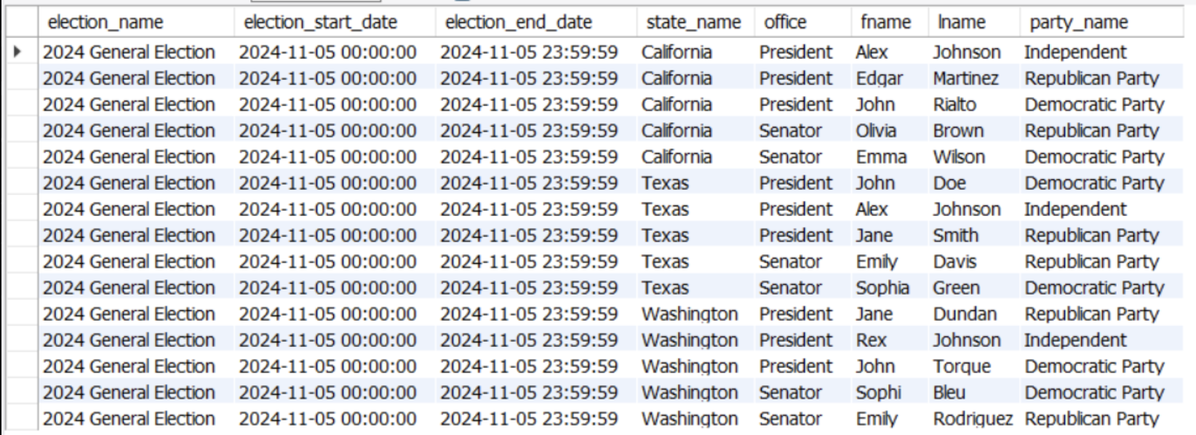
Election View
Notes:
Under the hood, what VoteMate is doing…

Slide 11
Social Media & Clickstreams
Notes:
Under the hood of VoteMate…

Slide 12

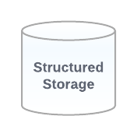
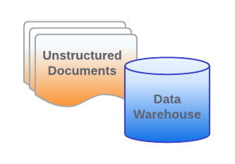
Data Ingestion & Management
Store unstructured/semi-structured data
JSON
Clickstreams
Social Media Feeds
Redundant
Scalable
Load Balancing
Analysis
ML
RDMS
Notes:
Touch main points of flow and reasoning.
We have decided to use Flume because its R S L
Allowing us to store various unstructured or semi.. data into our data lake and warehouse
Then it can be transferred to our RDMS for further BI and analysis.
We will do so using Spark… (next slide)

Slide 13
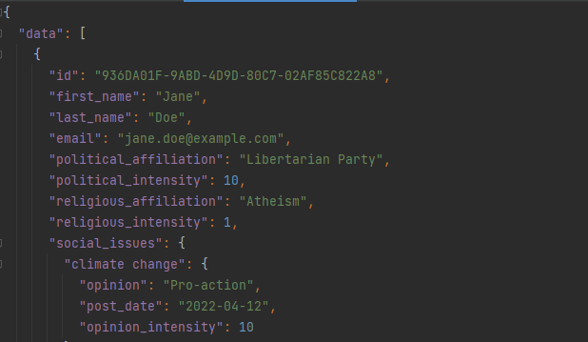

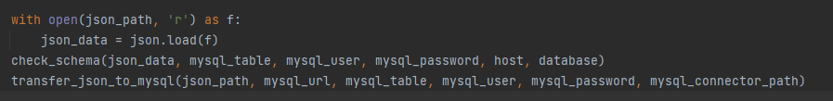
Notes:
Explain how pyspark works to quickly transform json into a RDMS.
loads up data as a json object.
use python to check that keys of json match the fields in the table.
Then data is transferred.
Would use flume agent to cache data, avoid data loss and process until final write to disk.
A workable solution recall from our past classes that Spark works in distributed memory avoiding the reads and writes required in the past.
Determining memory requirements for Spark (Side Note for personal info)
As a starting point, you can follow these steps:
Estimate the total amount of data per second: average log size (bytes) * 1000 logs/events.
Multiply the total data size by a factor of 2-3 (or more, depending on the complexity of the processing tasks) to accommodate the processing overhead.
Add memory overheads for Flume and PySpark. A typical setup might require at least 1-2 GB of memory for Flume and 2-4 GB of memory for the PySpark driver, plus additional memory for executor nodes depending on your cluster configuration.
After calculating the estimated memory requirements, it's always a good idea to monitor your application's performance and adjust your memory allocation as needed. You can fine-tune your PySpark application's memory settings using configuration parameters like :
spark.driver.memory
spark.executor.memory
spark.driver.maxResultSize.

Slide 14
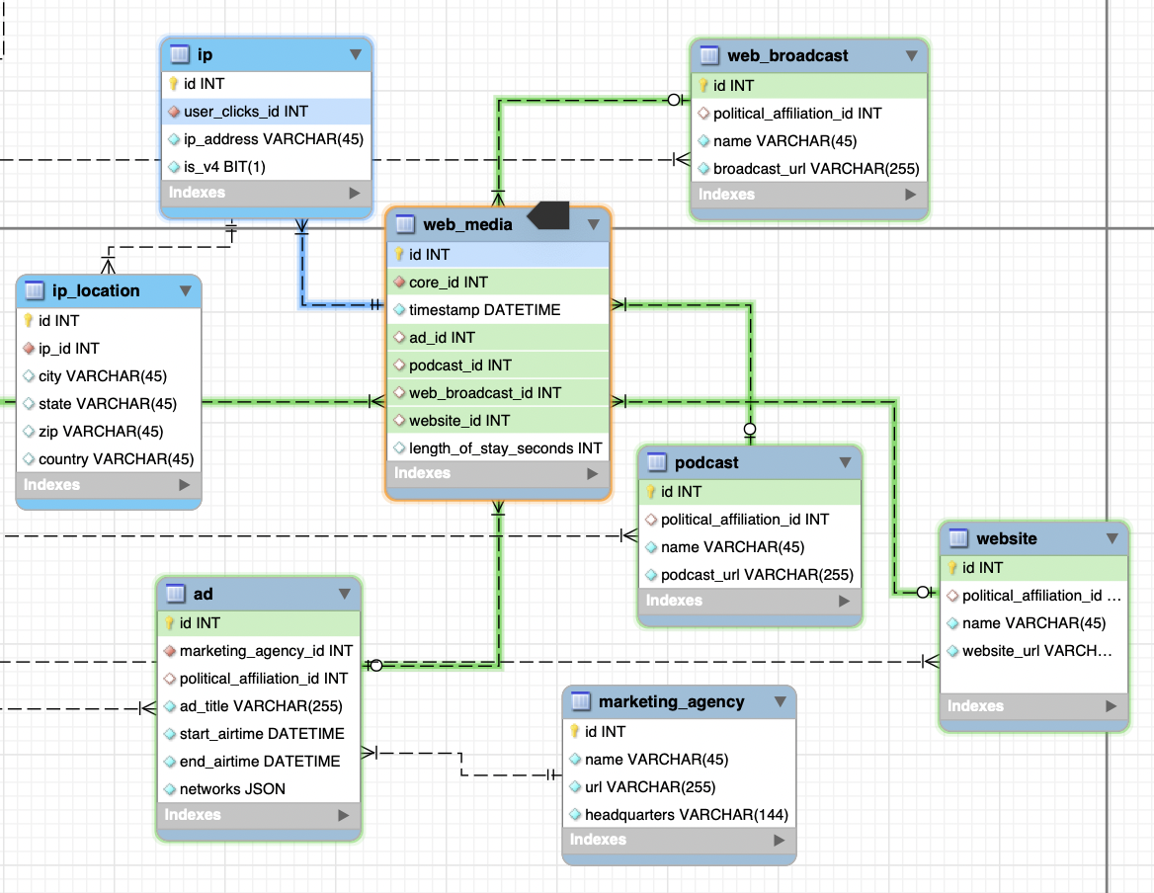
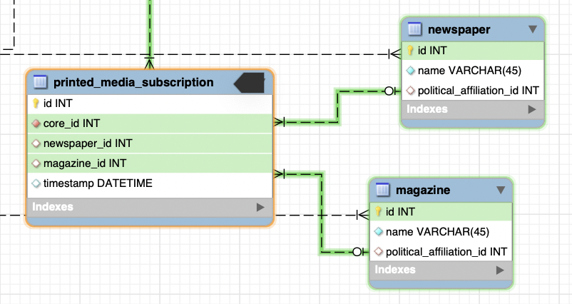
Clickstreams & Printed Media
The majority of web media is captured via clickstreams
Notes:
Here is our structure for storing clickstream and printed media data.
Describe the tables.

Slide 15
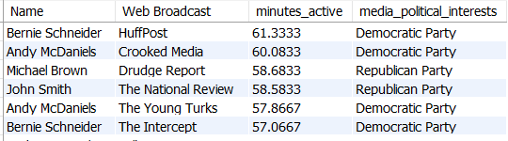
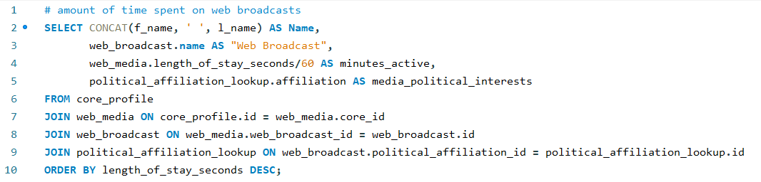
Data Prep
Web Broadcasts
Notes:
For a solution to determining extent of exterior influences, i found that classification algorithms like logistic regression, decision trees, random forests, or support vector machines may be well suited. These algorithms can handle categorical target variables and provide a probability or class label for each category, which may be more appropriate for the task of predicting political interests. With a large enough dataset we could predict voting outcomes and exterior influence with a high certainty.

Slide 16
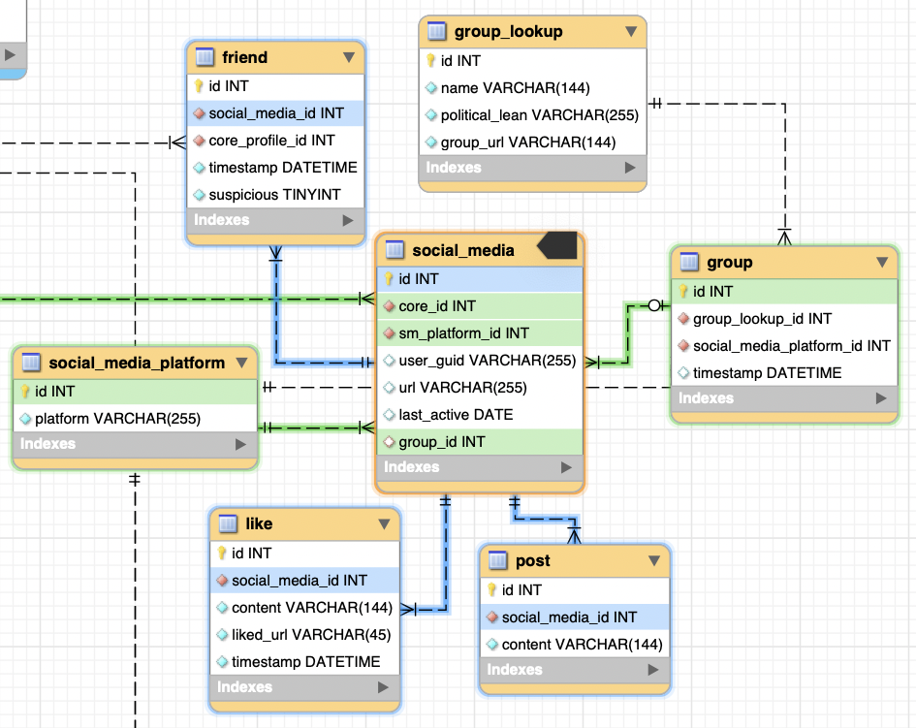
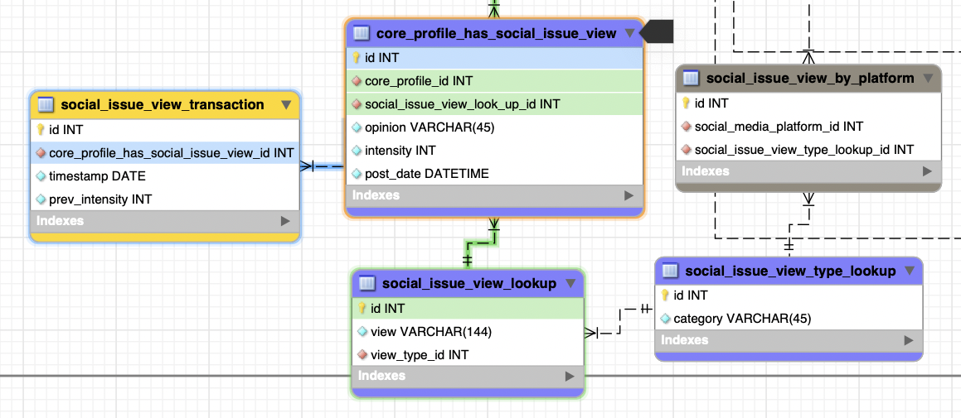
Social Media & Social Issues
PySpark and MLib would be used to perform ETL operations
Notes:
In this slide, we present a model for collecting and transforming data from a variety of social media platforms, each with unique underlying data structures, into a standardized and structured format. This transformation process, transitioning from the orange section to the purple section, enables the efficient management of large volumes of heterogeneous data.
By harmonizing the data into a unified structure, we can facilitate streamlined analysis and effectively implement machine learning strategies. This approach not only enhances our understanding of the underlying patterns in the data but also empowers us to develop predictive models that can accurately identify external influences on voting behavior.
Further in the orange table below the purple section, past opinions of varying intensity will be stored with the time stamp when they were posted. This will allow us to track changes and explore influences that are linked via the clickstream and printed media data.

Slide 17
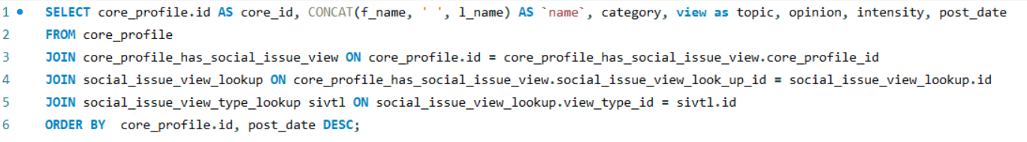
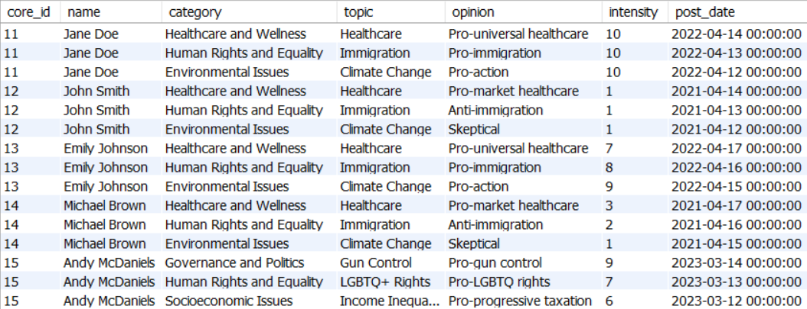
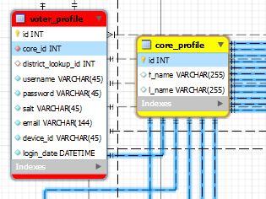
Data Prep
Notes:
Here you you can see how the data from the previous tables can be used to link voters to the core media data ingested into our database. By analyzing patterns in a core_profile record we can determine with any level of granularity the extent of exterior influences on voter decisions. The key to our design is ensuring we can link a voter to a core_profile. There might be delayed analysis on individuals who don’t have a large internet presence.
Brink is up next and will share with you how we determine the extent of exterior users on voter decisions.

Slide 18
Data Analytics

Slide 19



How to discover external influences?
Who are the influencers?
How to detect influence?

Slide 20
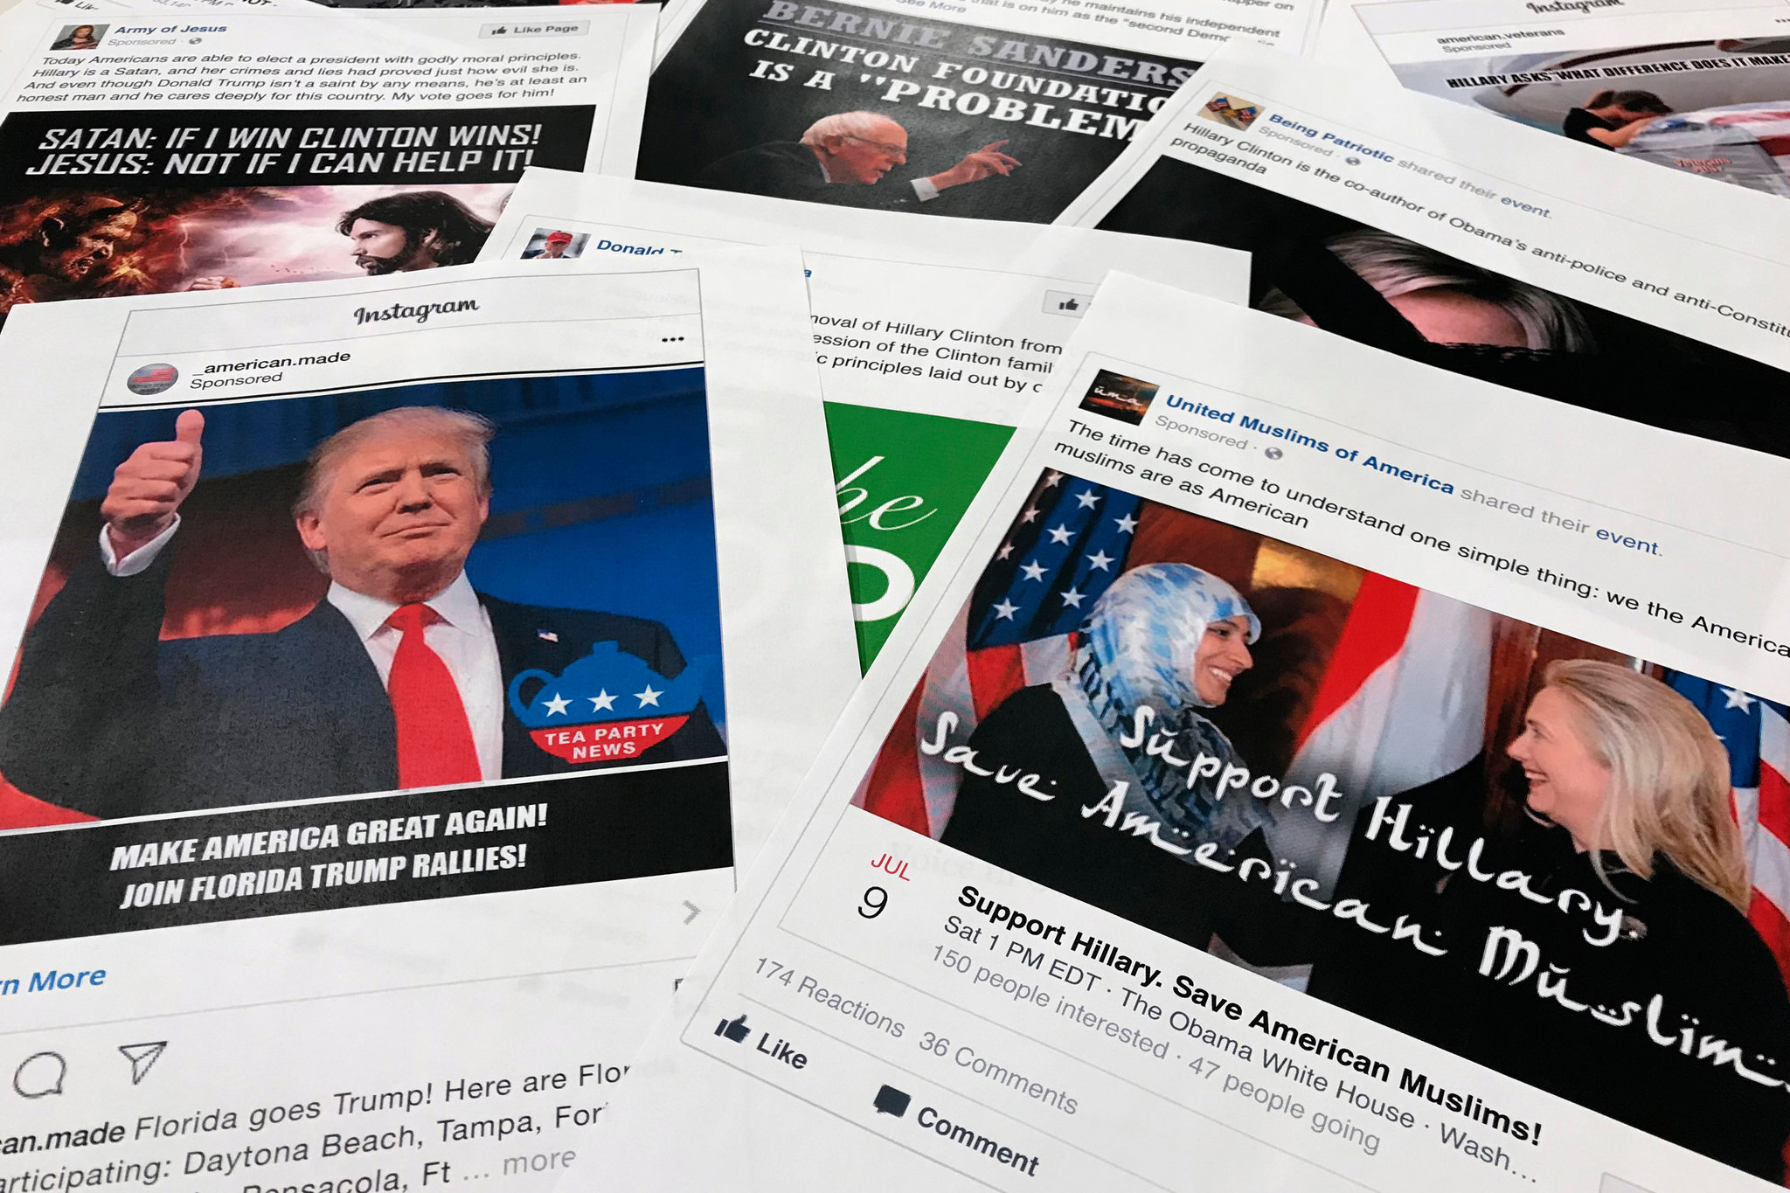
Possible Influences
International political groups
Domestic political groups
Corporations
Recommendation engines
Notes:
Talk about Russia in 2016
How do they influence–disinformation, troll farms

Slide 21

Detecting Influence
Prediction models
Identifying fake users
Tracking changes

Slide 22
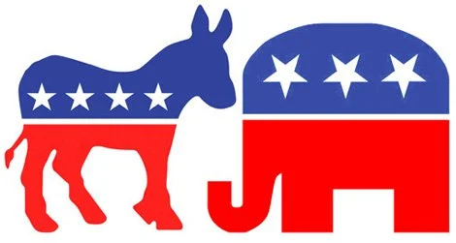
SELECT v.username, p.date, pl.party
FROM voter_profile AS v
JOIN party_registration AS p
ON v.id=p.voter_profile_id
JOIN voter_ballot_finished as vbf
on vbf.voter_profile_id = v.id
JOIN candidate as c
ON c.id = vbf.candidate_id
JOIN party_lookup as pl
ON pl.id = p.party_lookup_id;
SELECT v.username, pl.party, vbf.submission_time
FROM voter_profile AS v
JOIN voter_ballot_finished as vbf
on vbf.voter_profile_id = v.id
JOIN candidate as c
ON c.id = vbf.candidate_id
JOIN party_lookup as pl
ON pl.id = c.party_lookup_id;
Notes:
# what were they registered as and when did they register
# what party did they vote for and when

Slide 23

SELECT v.username, wm.timestamp, wm.length_of_stay_seconds, w.name, pal.affiliation
FROM voter_profile AS v
JOIN website as w
JOIN political_affiliation_lookup as pal
ON w.political_affiliation_id = pal.id
JOIN web_media AS wm
ON wm.website_id = w.id
ON wm.core_id=v.core_id
WHERE wm.timestamp BETWEEN
NOW() AND DATE_ADD(NOW(), INTERVAL -1 MONTH);
SELECT v.username, c.f_name, c.l_name, pa.intensity, pt.prev_intensity, pt.timestamp, pal.affiliation
FROM voter_profile AS v
JOIN core_profile AS c
ON c.id=v.core_id
JOIN core_profile_has_political_affiliation as pa
ON c.id = pa.core_profile_id
JOIN political_affiliation_lookup as pal
ON pal.id = pa.political_affiliation_id
JOIN political_transaction as pt
ON pt.core_profile_has_political_affiliation_id = pa.political_affiliation_id
WHERE pt.timestamp BETWEEN
NOW() AND DATE_ADD(NOW(), INTERVAL -1 YEAR);
Notes:
# viewing political affiliation and intensity over time
# viewing websites user has viewed, when they visited, how long they visited, what affiliation the sites had

Slide 24

SELECT SUM(f.suspicious) AS NumSuspiciousFriends FROM friend f
WHERE f.timestamp BETWEEN
NOW() AND DATE_ADD(NOW(), INTERVAL -1 YEAR);
SELECT f.suspicious, c.l_name, c.f_name, pal.affiliation
FROM core_profile AS c
JOIN core_profile_has_political_affiliation AS ca
ON c.id = ca.core_profile_id
JOIN political_affiliation_lookup as pal
ON ca.political_affiliation_id = pal.affiliation
JOIN friend as f
ON f.core_profile_id = c.id
WHERE f.timestamp BETWEEN
NOW() AND DATE_ADD(NOW(), INTERVAL -1 YEAR);
Notes:
# how many suspicious friends have they added over year before election
# suspicious friends' affiliations

Slide 25
The Real Product: Public & Private External Influence Report
For District 2:
Number of voters with significant suspicious friends: 899009
Number of voters with significant suspicious change: 892382
Percent of population with significant suspicious change: 1.8%
Correlates with web media: 63%
Correlates with print media: 12.6%
Correlates with social media: 78.4%

